Slide 1
Image Registration using 2D-FFT on FPGA
Project Mentor: Dr. K.C. Ray
G.Rajesh Yudhan Rajoo Ankur Vaish
(IEC2006001) (IEC2006014) (IEC2006056)

Slide 2
Problem Definition
The problem at hand is to find the scaling, rotation and translation in an image using 2D Fast Fourier Transform and implementing the developed algorithm on an FPGA Toolkit.

Slide 3
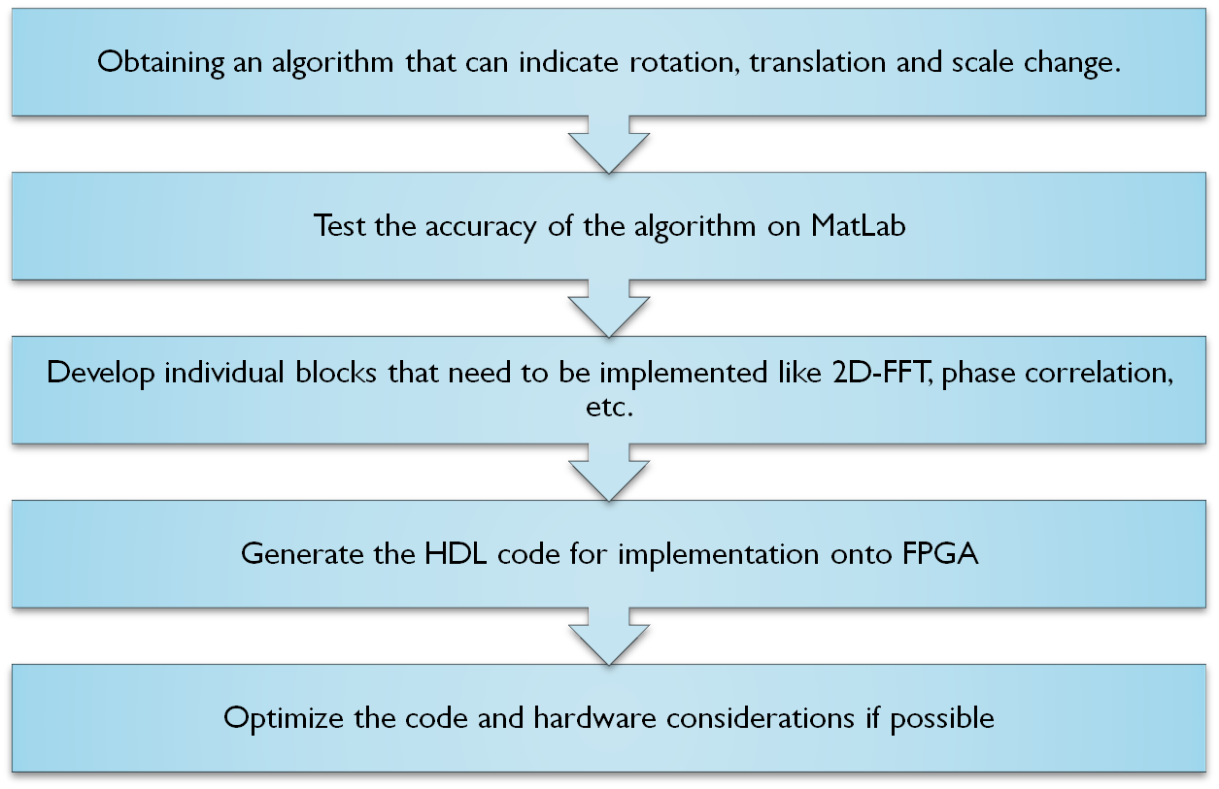
APPROACH TO THE PROBLEM

Slide 4
Image Registration
Feature detection
Feature matching
Transform model estimation
Image resampling and transformation

Slide 5
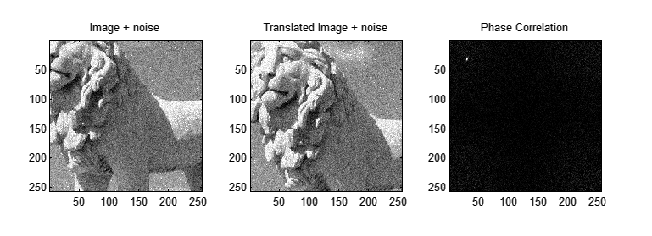
Algorithm to evaluate Translation Rotation and Scaling in images
Phase Correlation
Log Polar Conversions
2D FFT

Slide 6
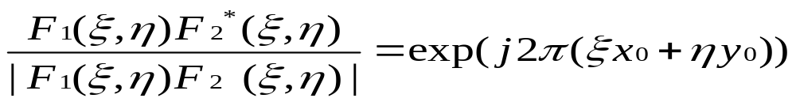
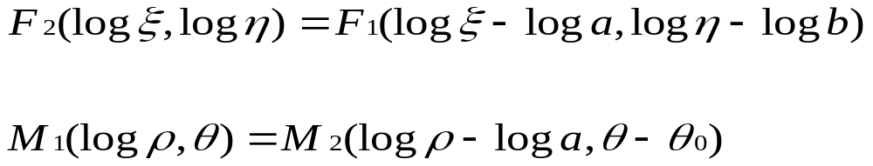
Significant Equations

Slide 7
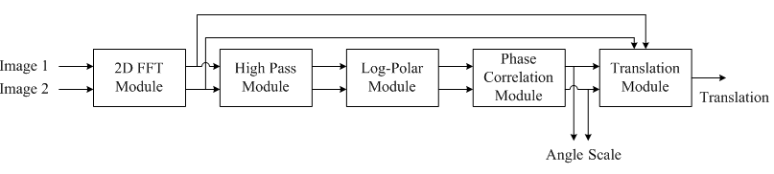
Block diagram representing the algorithm applied

Slide 8
Developments Made
MatLab implementation of Image Registration
MatLab implementation of 2D FFT using 1D FFT
System Architecture for 2D FFT

Slide 9
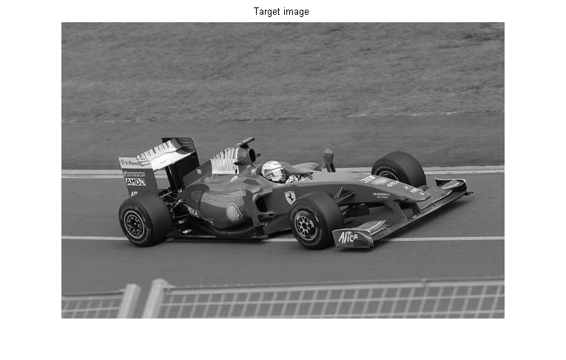
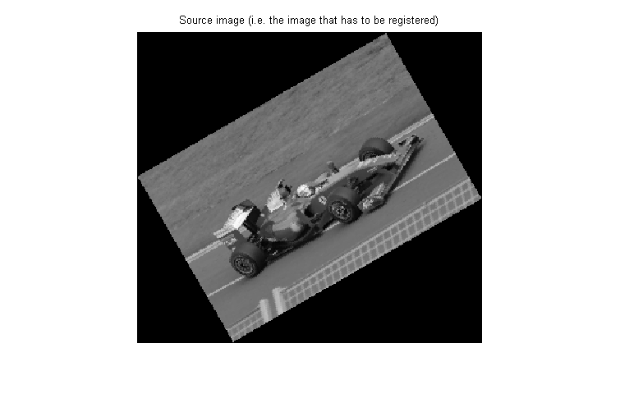
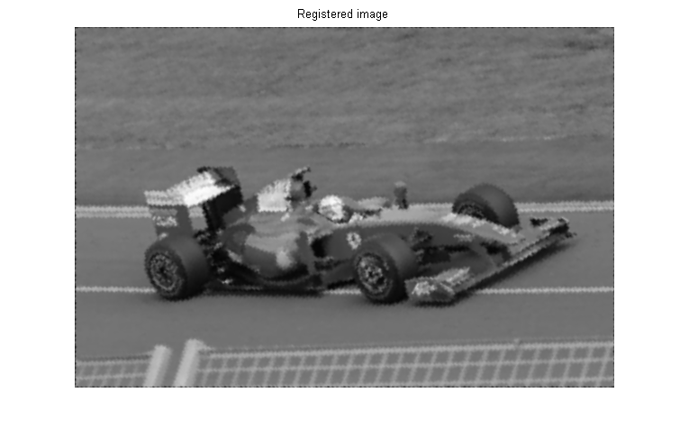
Image Registration Implementation Results

Slide 10
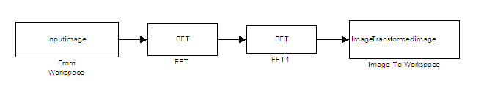

MatLab implementation of 2D FFT using 1D FFT
Block diagram showing 2D FFT implementation in the form of MatLab functions
Block diagram showing 2D IFFT implementation in the form of MatLab functions

Slide 11
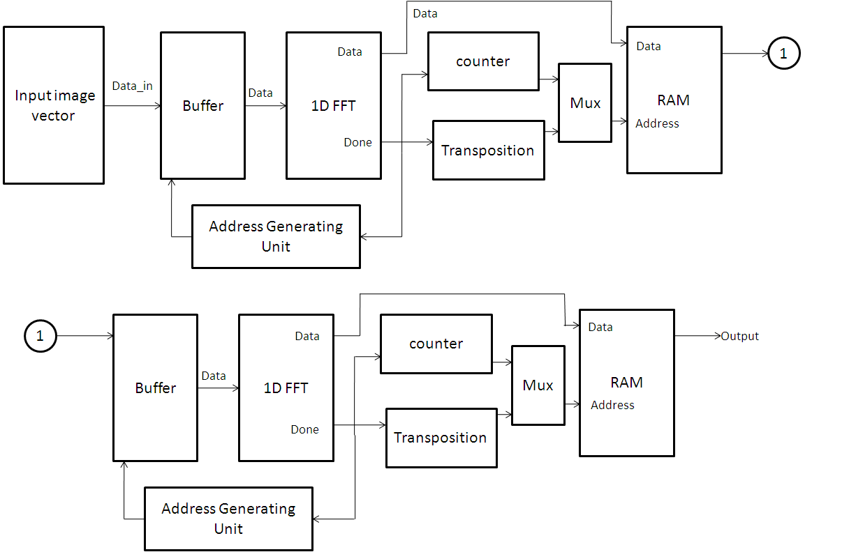
System Architecture for 2D FFT

Slide 12
CHALLENGES FACED
RESIZING OF IMAGES
TIME AND HARDWARE CONSTRAINT
LOG POLAR CONVERSION
FLOATING POINT PROBLEM

Slide 13
FUTURE GOALS
Development of individual blocks
Generation of the HDL code
Optimization of the code and hardware considerations

Slide 14
APPLICATIONS
Different viewpoints (multi view analysis)
Different times (multi temporal analysis)
Different sensors (multi modal analysis)
Scene to model registration
Remote sensing
Computer Vision
Medical imaging

Slide 15
REFERENCES
E. DE Castro and C. Morandi, “Registration of Translated and Rotated Images on Finite Fourier Tranforms”, IEEE Transactions on Pattern recognition and Machine Intelligence,Vol. PAMI-9 No.5,Sept. 1987,pp.700-703
B.Srinivas Reddy and B.N.Chatterji, “An FFT-Based Technique for Translation, Rotation, and Scale-Invariant Image Registration”, IEEE Transactions on Image Processing, Vol. 5, No. 8, August 1996, pp. 1266-1271
Barbara Zitova´, Jan Flusser, “Image registration methods: a survey”, Image and Vision Computing, 21 (2003), pp. 977–1000
I.S. Uzun, A. Amira and A. Bouridane, “FPGA implementations of fast Fourier transforms for real-time signal and image processing”, IEEE Proc.-Vis. Image Signal Process., Vol. 152, No. 3, June 2005, pp.283-296
J. Klymochko, W. Liu, A.Castillo and J.Vasquez, “Real Time 2D FFT Image Processing using Xilinx System Generator”, SAAEI 2006, pp. 432-438

Slide 16
THANK YOU

